Slide 1
Does the External Environment Impact Food Consumption?
Color, shape, visibility, size

Slide 2
Anna M. Page, MS. RDN. LD
Associate Professor, Director Honors Program, Johnson County Community College
Objectives:
Define the impact of color on food consumption
Differentiate between different dinnerware and food consumption
Assess how environment impacts perception of food quality
Apply how food nudges can be utilized

Slide 3
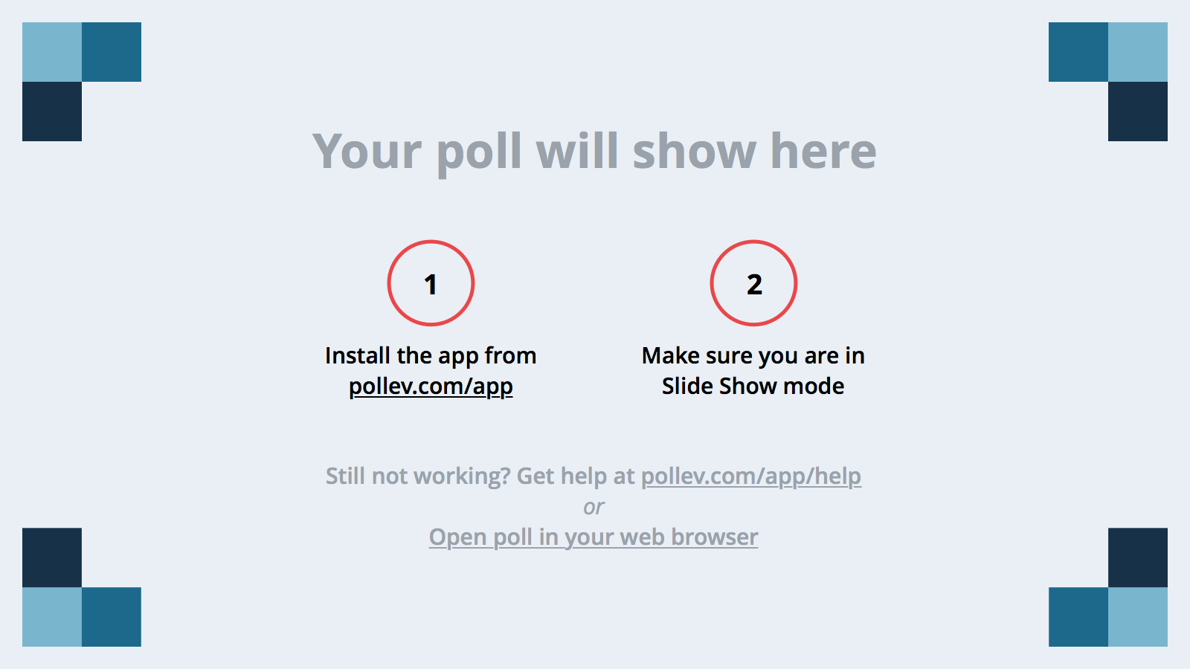
Notes:
Poll Title: Why Are You Attending This Session? https://www.polleverywhere.com/free_text_polls/Cmf7Y5x48tjLiIa

Slide 4
Color
Warm colors: Red, Orange and Yellow
stimulate and increase blood pressure and appetite
Cool colors: Blue, Green, Indigo and Violet
calm, reduce stress and blood pressure
At Home Eating Area Applications
Restaurant Applications

Slide 5
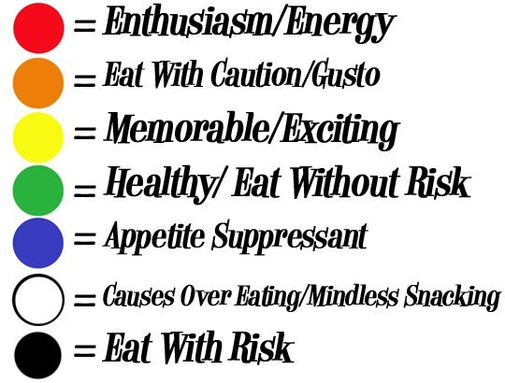

Slide 6
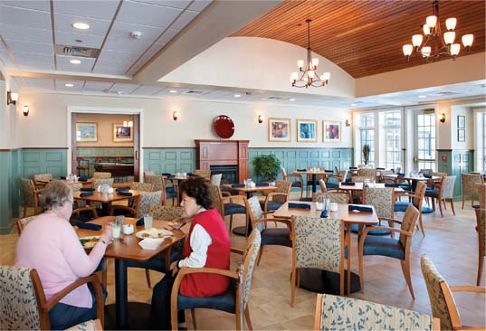
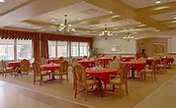

Slide 7
Color of the Plate
Diners serve themselves more food if the color of their food matches the color of their plate
People serve themselves less when their dinnerware and its background do not contrast in color
Placing dinnerware on a similarly colored background (tablecloth, etc.) can alter your perception and make you think your food “fills” more of the plate. Because of this, you’re less likely to over-serve yourself

Slide 8
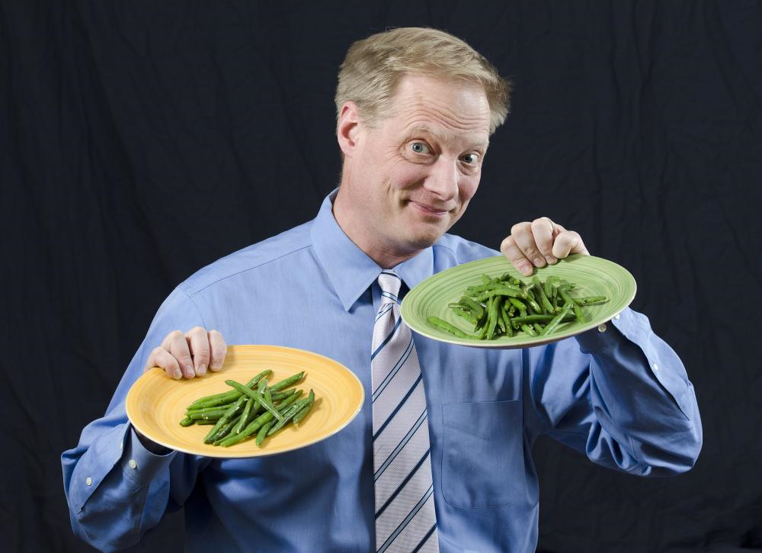

Slide 9
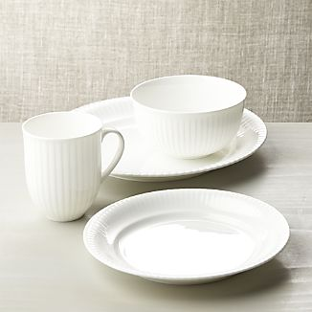
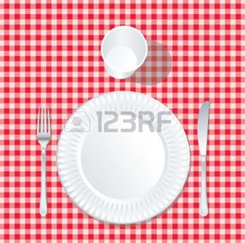

Slide 10
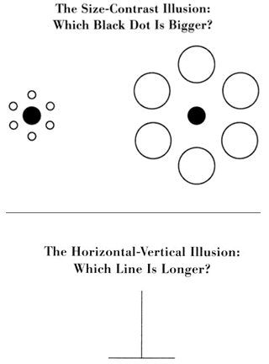
Delboeuf illusions
http://www.ncbi.nlm.nih.gov/pmc/articles/PMC3947396/

Slide 11
Size of Dinnerware
Research shows that people will eat and drink more with larger dinner and glassware.
Portion Distortion
Plates and bowls also may affect consumption patterns; a recent study found that, when provided an 8-ounce cereal bowl or a 16-ounce cereal bowl, both adults and children consume 44 percent more cereal if using the larger bowl.
Clean the Plate Club

Slide 13
PMC full text:Int J Obes (Lond). Author manuscript; available in PMC 2014 Nov 1.Published in final edited form as: Int J Obes (Lond). 2014 May; 38(5): 657–662. Published online 2013 Sep 5. doi: 10.1038/ijo.2013.169
Examples of pictures used as stimuliA) Standard stimulus (i.e. food size of 185 pixels on a plate with a 1/3 rim width-to-plate radius proportion) is on right; Rimless plate with same food size is on left and B) Standard stimulus is on left; same rim size with smaller food size is on right

Slide 14
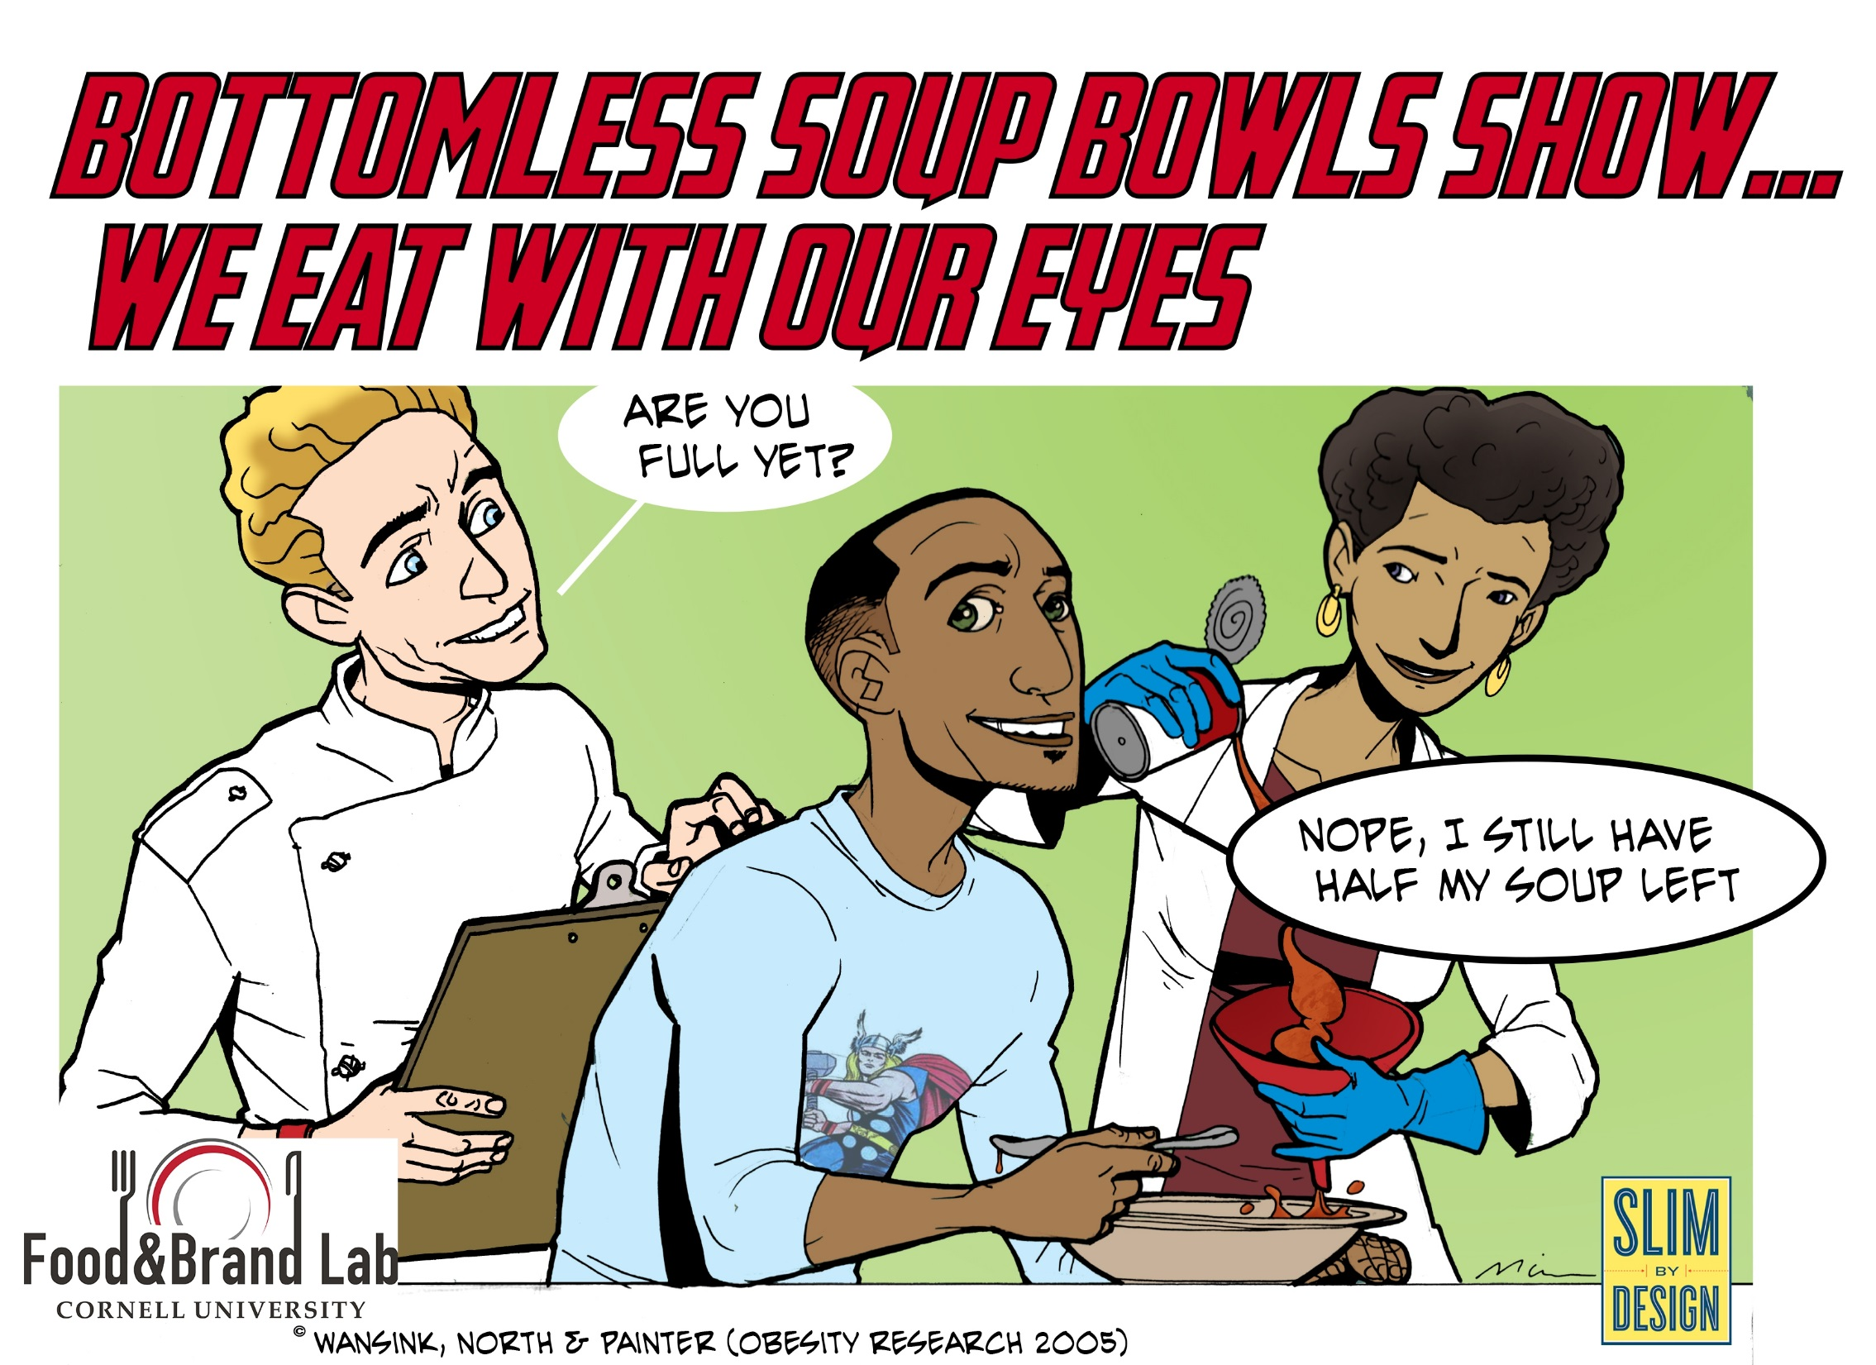

Slide 16
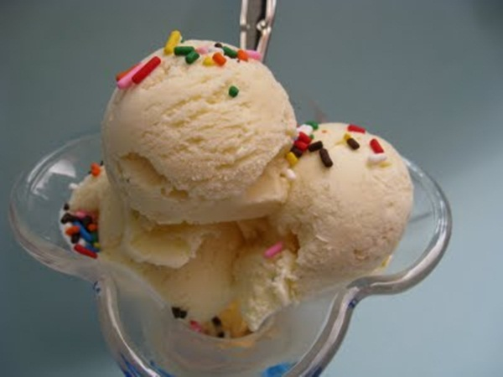
Ice Cream Study
Cornell University

Slide 17
To encourage people to consume more of certain foods such as fruits and vegetables, try using larger plates, bowls and utensils. If you want to limit consumption, use smaller serving utensils, plates and bowls. Considering Americans consume about 92 percent of what they serve themselves, influencing how much ends up on the plate is a great place to start.

Slide 18
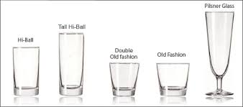
Beverages
Research has shown the average person will serve himself or herself up to 30 percent more of a beverage when it’s poured into a short-wide glass compared with a tall-thin glass

Slide 19
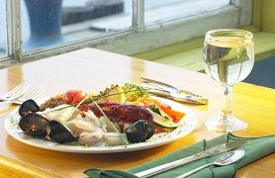
The Power of Plating
According to one study, adults prefer three components and three colors on their dinner plates, while children prefer seven different components and six different colors. The perception of choice also has a profound impact on consumption; research suggests when we perceive more variety, consumption increases by almost 77 percent.

Slide 20
Color or Taste?
Jelly bean mixture compared to one color consumed almost twice as much
7 colors of M & M’s equals 56
10 colors of M & M’s equals 90

Slide 21
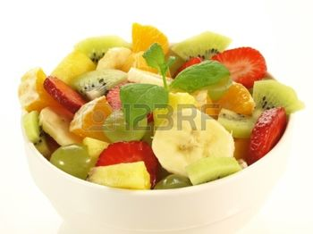
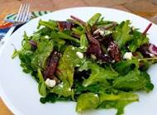
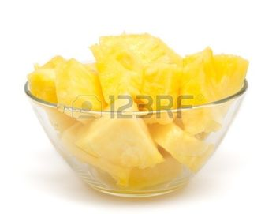
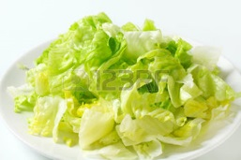
Color Variety

Slide 22
Type of Service
When you serve yourself, you are 92% more likely to eat what is on your plate.
Buffets
People will consume more of the food at the beginning of a buffet line
Where should we put the healthy food?
Trays
Going ‘trayless’ may decrease food consumption and food waste BUT
More current research indicates people leave off the salad but keep the dessert…maybe just smaller trays?

Slide 23
Ideas?
Healthy food in large dinnerware
Less healthy food in small dinnerware
Healthy food served on same color plates
Green salad on green plates
Healthy beverages served in short wide glasses
Less healthy beverages served in long tall glasses
Encourage self-service for healthy foods-family style versus served
Plate less healthy foods

Slide 24
Enhance Taste Expectations
Enhance Taste Expectations Effectively describing food as “tasting great” means using words that are sensory and help to prime consumers for the dining experience. A study examined the effects of identifying vegetables with creative, age-appropriate names, such as “X-Ray Vision Carrots” or “California Blend Veggies,” in three schools (elementary, middle and high school). Selection and consumption rates of carrots doubled in the elementary school and vegetable selection in the high school increased by more than 40 percent.

Slide 25
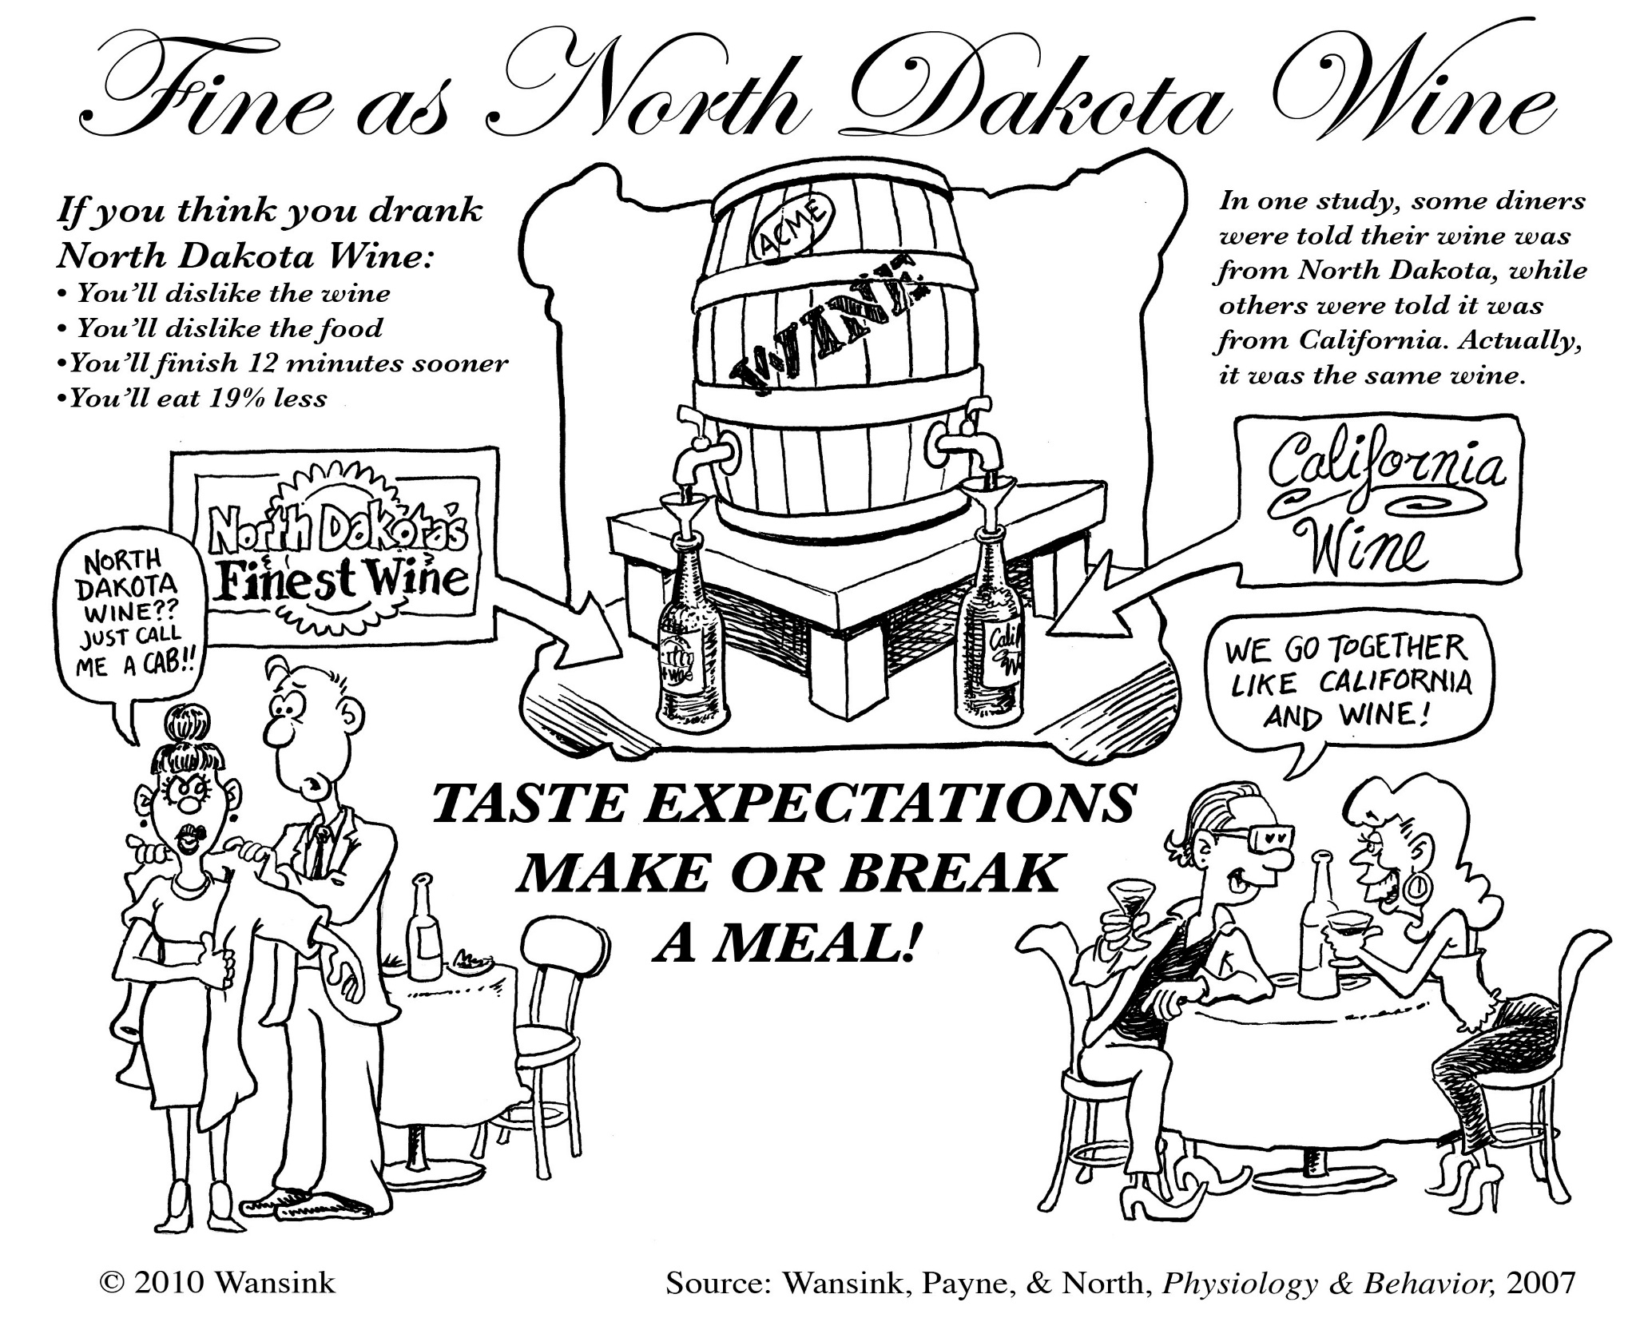

Slide 26
To encourage people to consume more of certain foods such as fruits and vegetables, try using larger plates, bowls and utensils. If you want to limit consumption, use smaller serving utensils, plates and bowls. Considering Americans consume about 92 percent of what they serve themselves, influencing how much ends up on the plate is a great place to start.

Slide 27
Increase Convenience & Visibility
Increase Convenience and Visibility Just as many home refrigerators relegate fresh produce to the bottom drawers (where they are out of sight and often out of mind come snack time), in cafeterias, fruits and vegetables often are located behind sneeze shields and in chaffing dishes. One study found whole fruit highlighted in a bowl by the register in high schools increased the selection of fruit by approximately 102 percent. Another found that placing skim white milk in front of other beverage options in the dairy case increased white milk sales by 46 percent. .

Slide 28
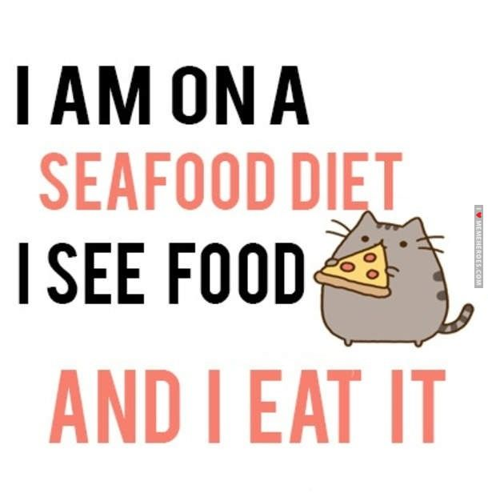

Slide 29
Studies show…
Snacks-in a drawer, at your desk, up high? Which ones will you consume more of?
Foods in opaque containers in the fridge and pantry.
Food you want to consume more visible
Food you do not want to consume less visible

Slide 30
Food Nudges
Placement Matters – Shoppers are less inclined to take items as their baskets fill up. For this reason, it is important to place Foods to Encourage early in a shopper’s path when their baskets are relatively empty.
Price tags are important – This is even the case when the person choosing the food is not paying monetarily. A price tag signifies that something is valuable, and when a product has a price tag, a shopper is one-third more likely to pick that product up.
Signage Helps – Waiting areas can be great places to encourage healthy food selection. Posters that display attractive images of Foods to Encourage can lead shoppers to select the pictured items when they are making food choices.
http://healthyfoodbankhub.feedingamerica.org/

Slide 31
Food Nudges
Abundance Counts – The appearance of abundance also leads to selection. This means that showcasing more Foods to Encourage will increase the amount of healthy food people select. It also means the opposite is true –decreasing the visibility of less-nutritious foods will limit their selection. This is true when showcasing fresh produce, it is important to present it in containers that appear to be fully stocked. When a shelf, box or crate appears mostly empty, shoppers are more likely to pass up the contents.
Visibility is key – Shoppers like to see the products they are choosing. In addition to representing abundance, ensure the visibility of Foods to Encourage items by angling the food crate down so the crate’s lip does not obscure the shopper’s view. This truly showcases the product – which as mentioned – can help increase its selection

Slide 32
https://youtu.be/aJmgN5wavNY

Slide 33
Brainstorm
How can you change your environment?
What color is your kitchen/dining room, plates, tablecloths?
What size are your dishes and glasses?
What food nudges can you use?
How and where do you store food?
How is food served in your home?
Think about color of the food and variety of the food you eat.
Assess your favorite restaurants

Slide 34
Notes:
Poll Title: How Can You Change Your Food Environment https://www.polleverywhere.com/free_text_polls/AMxCFTtFqQiJ9Ld

