Slide 1
Trust in Relationships, Teams, and Organizations
On one side of your card:
Write your autobiography using only 7 words
On the other side of your card:
Write 7 words that you associate with the word “trust”
KCPDC Professional Development Conference
May 24, 2017

Slide 2
Trust in Relationships, Teams, and Organizations
KCPDC Professional Development Conference
May 24, 2017

Slide 3
Preface…
You don’t need a title to be a leader.
You can make a positive difference,
whatever your title or position.
~ Mark Sanborn

Slide 4
Experiential Activities
Concentric Circles
Linked In
Human Knot
Find Your People
Trust Leans
Blind Walk
Debrief

Slide 5
Experiential Activities
Concentric Circles
Linked In
Human Knot
Graffiti Wall
Find Your People
Trust Leans
Blind Walk
Debrief
Men build too many walls and not enough bridges.
~ Sir Isaac Newton

Slide 6
What is trust?
Trust is not simply a matter of truthfulness, or even constancy.
It is also a matter of amity and goodwill.
We trust those who have our best interests at heart,
and mistrust those who seem deaf to our concerns.
~Gary Hamel

Slide 7
Experiential Activities
Concentric Circles
Linked In
Human Knot
Graffiti Wall
Find Your People
Trust Leans
Blind Walk
Debrief

Slide 8
What is trust?
Trust is…
Trust requires…
a feeling
a belief
an expectation
a decision
a competency
an economic driver
connection
risk
vulnerability
courage
awareness
character

Slide 9
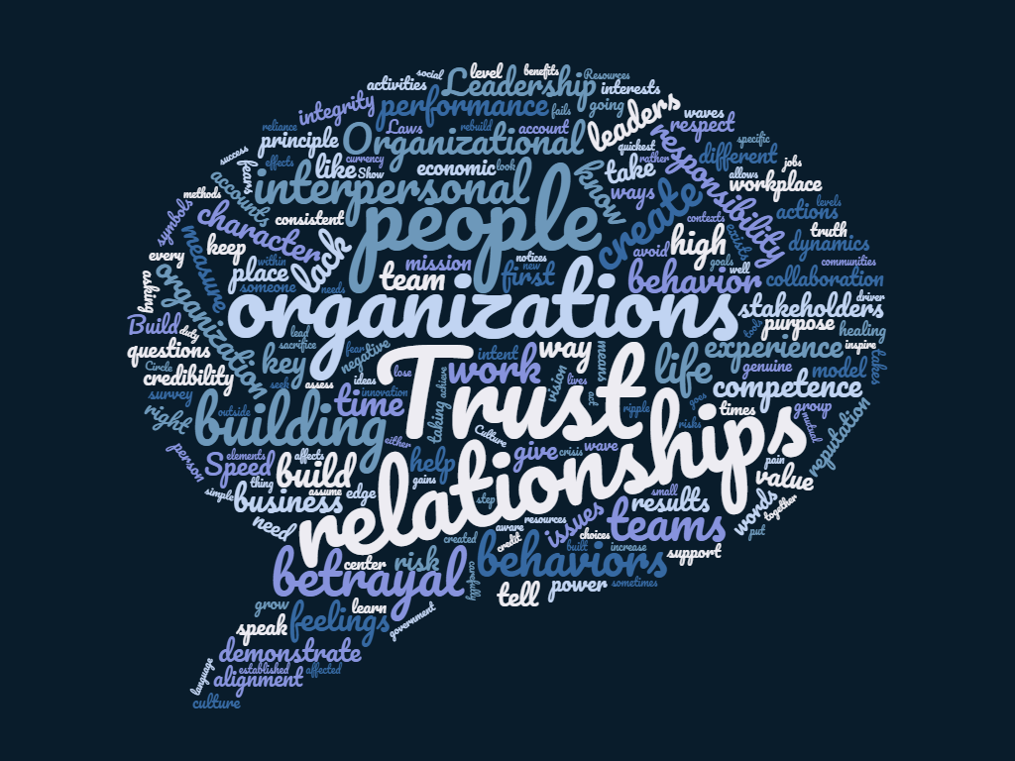

Slide 10
How do we know when trust exists – or when it doesn’t?
The best way to find out if you can trust somebody is to trust them.
~ Ernest Hemingway
Trust is the most significant predictor of individual’s
satisfaction within their organization.
~ Jim Kouzes and Barry Posner
If there is any great secret of success in life, it lies in the ability to
put yourself in the other person’s place and to see things
from his point of view – as well as your own.
~ Henry Ford
Notes:
Think about someone you trust implicitly. Why do you trust that person, and how do you know?
Think about your current team at work or your organization as a whole. Close your eyes… give your team a “trust” score on a scale of 1 to 10 (1 is lowest, 10 is highest), and hold up that number of fingers.

Slide 11
Experiential Activities
Concentric Circles
Linked In
Human Knot
Graffiti Wall
Find Your People
Trust Leans
Blind Walk
Debrief

Slide 12
What are the benefits when trust exists?
The 7 High Trust Organizational Dividends
Increased value
Accelerated growth
Enhanced innovation
Improved collaboration
Stronger partnering
Better execution
Heightened loyalty
Without trust, words become the hollow sound of a wooden gong. With trust, words become life itself.
~ John Harold

Slide 13
What are the consequences when it doesn’t?
A lie can travel half way around the world
while the truth is putting on its shoes.
~ Charles Spurgeon
What upsets me is not that you lied to me,
but that I can no longer believe you.
~ Friedrich Nietzsche
Mistrust doubles the cost of doing business.
~ John Whitney

Slide 14
What are the consequences when it doesn’t?
The 7 Low Trust Organizational Taxes
Redundancy
Bureaucracy
Politics
Disengagement
Turnover
Churn
Fraud
Our distrust is very expensive.
~ Ralph Waldo Emerson

Slide 15
What can we do to build and maintain trust?
Men build too many walls and not enough bridges.
~ Sir Isaac Newton
Trust each other again and again. When the trust level gets high enough, people transcend apparent limits, discovering new and awesome
abilities of which they were previously unaware.
~ David Armistead

Slide 16
What can we do to repair or rebuild trust?
You can’t talk yourself out of a problem you’ve behaved yourself into.
~ Stephen R. Covey
No, but you can behave yourself out of a problem
you’ve behaved yourself into… and often faster than you think.
~ Stephen M.R. Covey

Slide 17
What can we do to repair or rebuild trust?
The best time to plant a tree is twenty years ago.
The second best time is today.
~ Chinese Proverb

Slide 18
Experiential Activities
Concentric Circles
Graffiti Wall
Linked In
Human Knot
Find Your People
Trust Leans
Blind Walk
Debrief

Slide 19
Experiential Activities
Concentric Circles
Graffiti Wall
Linked In
Human Knot
Find Your People
Trust Leans
Blind Walk
Debrief

