Slide 1
Becoming Aware of Microaggressions
Sarah Fox-Linton
University of Saint Mary
Notes:
Identify a time when they were an “other” (woman in a group of men, man in a group of all women, person of color in an all-white group; a white in a group that is all people of color, travelled to a different country where they didn’t know the language) and identify 3 thought/feelings that came up for them in that setting, and share it with another participant.

Slide 2
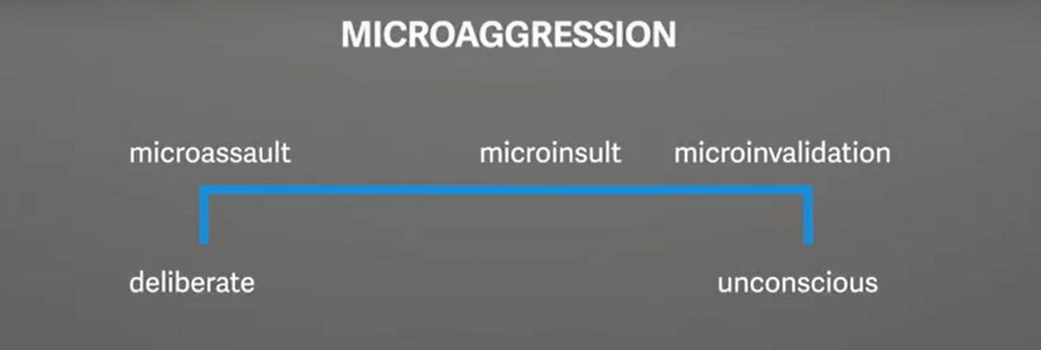
Classification of Microaggressions
(Quartz 2016)
Notes:
https://www.youtube.com/watch?v=BJL2P0JsAS4

Slide 3
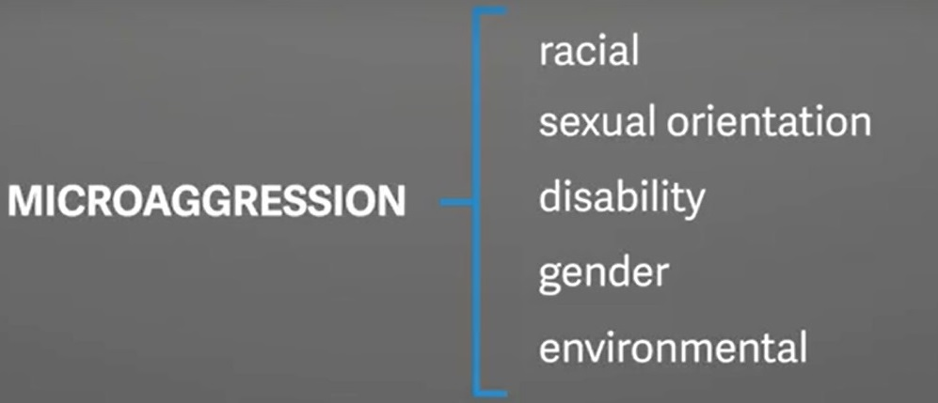
What do microaggressions include?
Environmental microaggressions send the message:
  You don’t belong.
  You won’t succeed.
  You are an outsider.
  You don’t exist.
  (Sue et al., p. 277, 2007)

Slide 4
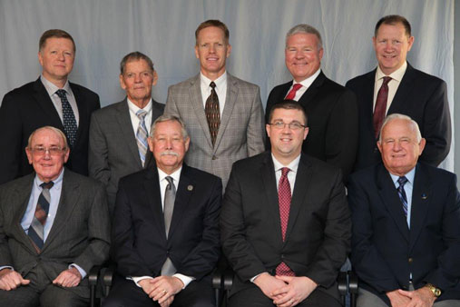
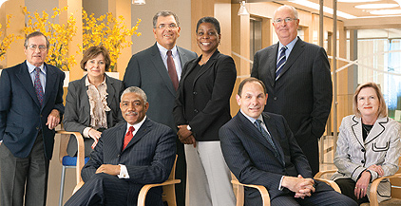
Environmental Microaggressions

Slide 5

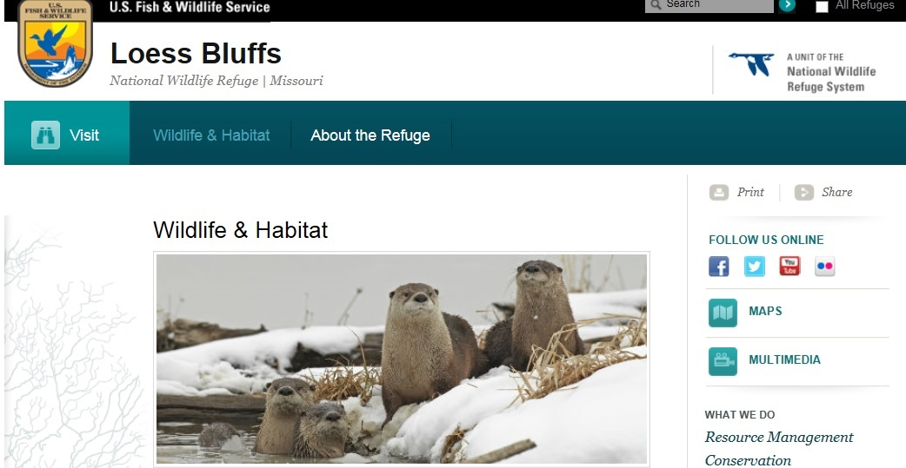
Environmental Microaggressions

Slide 6
Activity
Read the categories of microaggressions in your chart and note the ones you hear in the videos.
https://www.youtube.com/watch?v=PMJI1Dw83Hc
http://www.npr.org/2014/11/17/361804353/six-words-with-kids-im-dad-alone-thug

Slide 7
Why are microaggressions stressful?
More stressful events: | Less stressful events:
Stem from an unclear cause | Stem from an obvious cause
Are frequent or continual | Are one-time or with a designated end date
Affect many aspects of life, such as work, school and social interactions. | Affect fewer areas of one’s life
(Sue, p. 96, 2010)
Notes:
In some respects, people of color may find an overt and obvious racist act easier to handle than microaggressions that seem vague or disguised. (Solo
´rzano et al., 2000).

Slide 8
Cognitive effect of microaggressions
“The immediate reaction might be a series of questions: Did what I think happened, really happen? Was this a deliberate act or an unintentional slight? How should I respond? Sit and stew on it or confront the person? If I bring the topic up, how do I prove it? Is it really worth the effort? Should I just drop the matter?” (Sue et al., p. 279, 2007)
In a study, medical teams who received rude comments made errors such as asking for the wrong medication, mixing the wrong medication and performing medical procedures incorrectly (McKnight, 2015)
Notes:
Start video at 2:48 min. https://www.youtube.com/watch?v=AoT-nmSdAOs

Slide 9
If you experience a microaggression
Talk with other people who have similar experiences.
Shift the blame from yourself to the other person.
Try to separate the person from his or her beliefs.
  (Sue, p. 74-77, 2010)

Slide 10
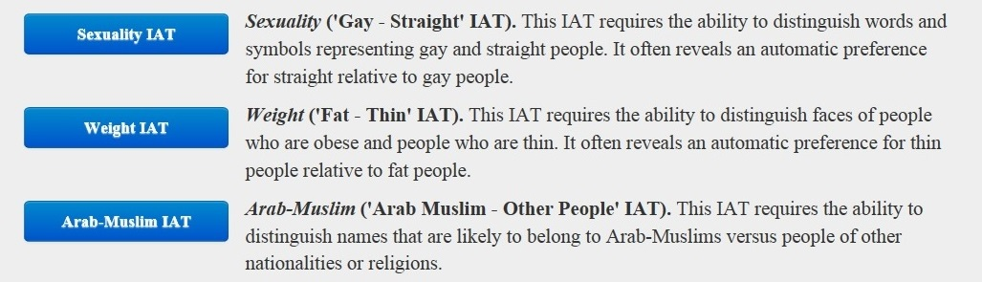
How can you become aware of your implicit bias?
Harvard’s Project Implicit
Notes:
The IAT measures the strength of associations between concepts (e.g., black people, gay people) and evaluations (e.g., good, bad) or stereotypes (e.g., athletic, clumsy). The main idea is that making a response is easier when closely related items share the same response key.

Slide 11
How can you avoid acting on implicit bias?
Avoid putting yourself in situations where you can act on implicit bias. For example, remove names from resumes if you are on a search committee.
Make an effort to include people you have an implicit bias toward.
Consider how your bias is formed. Try watching movies and TV shows that show people in counter-cultural ways. (Frequently Asked Questions, 2011)

Slide 12
References
Frequently Asked Questions. (2011). Project Implicit. Retrieved from https://implicit.harvard.edu/implicit/faqs.html
BuzzFeedVideo, (2014, June 6). If Asians said the stuff white people said. Retrieved from https://www.youtube.com/watch?v=PMJI1Dw83Hc
McKnight, T. (2015, October 26). Rudeness in medical settings could kill patients. New York Magazine. Retrieved from http://nymag.com/scienceofus/2015/10/rudeness-in-hospitals-could-kill-patients.html
NPR Staff, (2014, November 17). Six words: ‘With kids, I’m dad. Alone, thug.’ National Public Radio. Retrieved from http://www.npr.org/2014/11/17/361804353/six-words-with-kids-im-dad-alone-thug
Porath, C. (2016, May 24). How incivility shuts down our brains at work. Re: Work with Google. Retrieved from https://www.youtube.com/watch?v=AoT-nmSdAOs
  Quartz. (2016, Sept. 21). What is the definition of microaggression? Quartz. Retrieved from https://www.youtube.com/watch?v=bjzWENcW6NQ
Sue D.W..; Capodilupo, C.; Torino, G.; Bucceri, J.; Holder, Aisha, M.B.; Nadal, K.; & Esquilin, M. (2007). Racial microaggressions in everyday life: implications for clinical practice. American Psychologist, 62(4), 271-285.
Sue, D.W. (2010, October 4). Microaggressions in everyday life. Wiley. Retrieved from https://www.youtube.com/watch?v=BJL2P0JsAS4
Sue, D.W. (2010). Microaggressions in everyday life: race, gender and sexual orientation. John Wiley & Sons: Hoboken, N.J.

