Slide 1
LEADING OUR AMERICAN HEROES ON THE LABOR FRONT
PRISCILLA SUBRAMANIYAM, MBA may 23, 2018

Slide 2
What we will cover:
Support/Workforce re-entry skills: Understand the unique challenges that veterans face when trying to get back into the job force.
Professional assistance: Identify ways to better support our American heroes with opportunities that give them a “hand up.”
Resources for veterans: Learn about national and local organizations that serve our veteran population.

Slide 3
Understanding the veteran LABOR FORCE

Slide 4
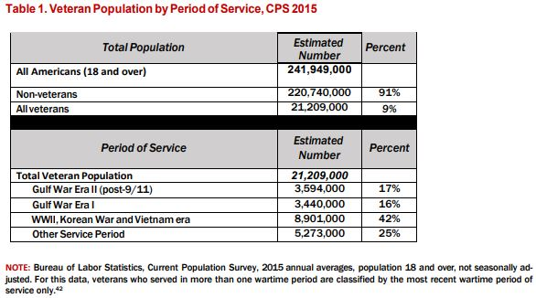
Veteran population by period of service

Slide 5
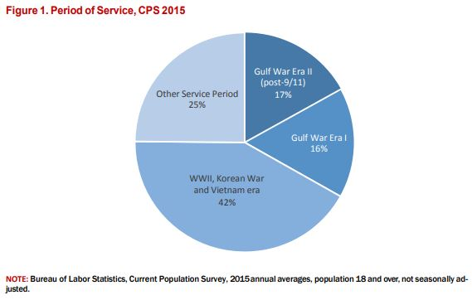
PERIOD OF SERVICE

Slide 6
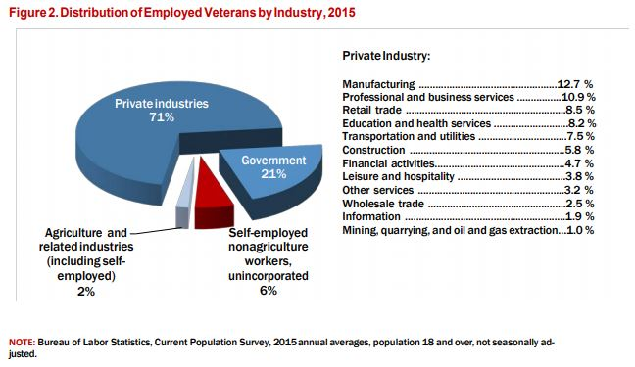
Distribution of employed veterans by industry

Slide 7
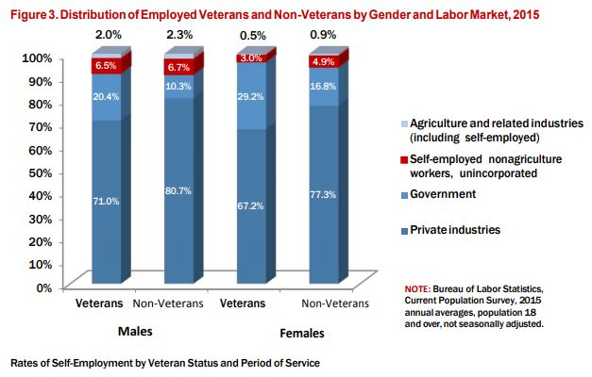
Distribution of employed and non-veterans by gender and labor market

Slide 8
Top transitional challenges FOR VETERANS
Navigating VA programs, benefits and services – 59%
Finding a job – 55%
Financial struggles – 47%
Depression – 41%
Getting socialized to civilian culture – 38%
Skills translation – 37%
Contradictory information from different sources – 33%
Disability – 32%
Understanding of GI bill benefits – 31%
Employment preparation – 30%

Slide 9
Experiences of Service Life Differ Greatly by Service Member Gender
Service had a positive impact on their life - 95% males 93% females
Felt pride from their accomplishments during service - 97% males 96% females
Matured as a result of their service - 97% males 96% females

Slide 10
Each veteran has a unique military and/or deployment experience even if they have the same mission as the person next to them. I think it is critical that we look at the individual independently of others when planning their integration into the civilian sector. We must not use a one-size approach as no service member is the same.
Monica riggs

Slide 11
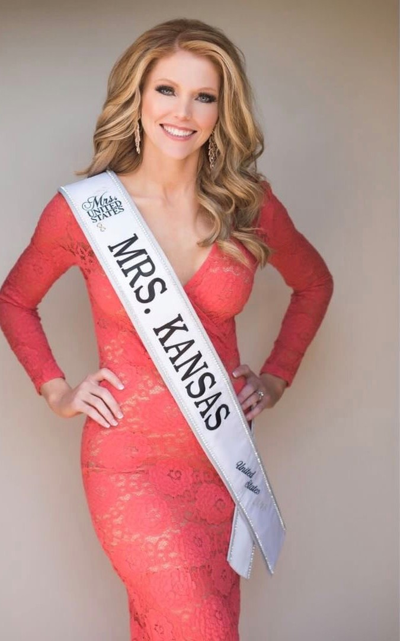
MONICA RIGGS
U.S. Air Force Major
Instructor Pilot: KC-135 Stratotanker
Mrs. Kansas United States 2018

Slide 12
Top Skills & Attributes Strengthened by Military Service
Work ethic & discipline
Teamwork
Adaption to different challenges
Mental toughness
Leadership and management skills
Professionalism
Ability to get things done
Perseverance
Training and teaching others
Self-discipline
Coping with adversity

Slide 13
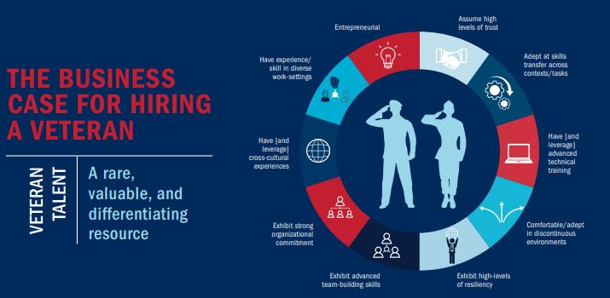
Veteran talent: a rare, valuable and differentiated resource
Entrepreneurial
Assume high levels of trust
Adept at skills transfer across contexts and tasks
Leverage advanced technical training
Comfortable and adept in discontinuous environments
Exhibit
High level of resiliency
Advanced team-building skills
Strong organizational commitment
Leverage cross-cultural experiences
Experience and skills in diverse work settings

Slide 14
The unique challenges veterans face in the labor force are assimilating to civilian culture, lifestyle, and feeling a sense of purpose. Prior to transitioning, many military members work on their resumes but it never fully prepares them for the reality of applying for jobs in the civilian force. The job market is more complicated than it seems and jobs do not come easy. Also, after wearing a uniform everyday for so many years, figuring out what is work appropriate attire can be a challenge. Veterans encounter a need to shift their mindset, realizing that they will not encounter the same camaraderie they had while in service. This presents a dilemma and compounds feelings of trying to discover meaning in what they do compared to what they did while they served.”
Anna kerry

Slide 15
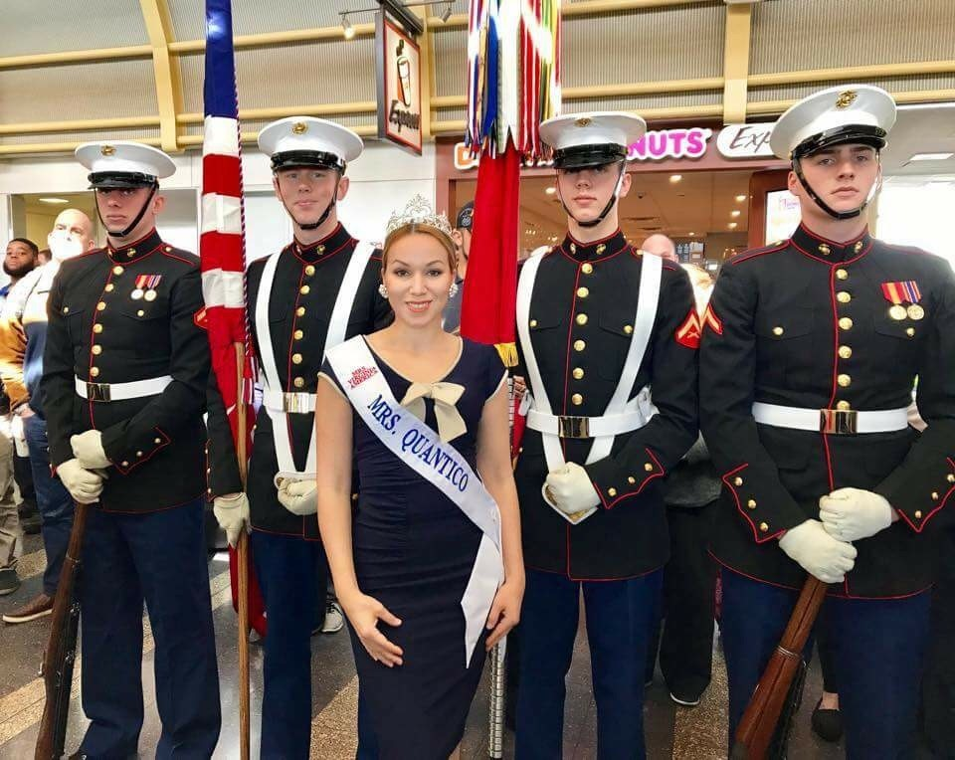
ANNA KERRY
U.S. Navy Lt. Surface Warfare Officer
Mrs. Quantico America 2019

Slide 16
PROFESSIONAL ASSISTANCE

Slide 17
Employment for veterans
unemployment
Post-9/11
Male veteran unemployment - 3.6%
Female veteran unemployment – 4.1%
Male veteran unemployment – 4.3%
Female veteran unemployment – 5.5%

Slide 18
Entrepreneurship for Women Veterans
About 15% of veteran-owned businesses are owned by women
Obstacles
Female veterans experience at least one obstacle/barrier to starting and owning their business – 83%

Slide 19
HOW A VETERAN CAN TRANSFER THEIR MILITARY SKILLS INTO A CAREER
Leadership
This is the trait that all Veterans have. Most Veterans leave the military having some form of leadership experience. Some Veterans led entire commands, while others were responsible for a single human being. Either way, that experience is valuable for the work place.
Combine leadership experience with initiative and decision making and you have a character any employer would be proud to hire.
Follower
The other side of that coin is how good of a follower veterans are as they spend their entire military service following and obeying orders. Not every employer is looking to hire a manager, supervisor or person specifically meant to lead.
Veterans can Stand out by explaining how they followed orders and took initiative based on the commander’s intent, Even if they are applying for a leadership position.
Teamwork
A successful unit requires teamwork. That includes good leadership, obedient and effective followers and strong collaboration among peers. Teamwork and company culture are important for many organizations.
Veterans can List an example of where they were a part of a strong team and describe that experience in the interview.

Slide 20
Reasons for Pursing Entrepreneurship
Dissatisfaction with the civilian workforce
Creativity & flexibility
Financial & independence
Recognize business opportunities
Family & work-life balance

Slide 21
Helpful Resources and Assets for Veteran Success
Military/veteran friendly campus – 64%
Flexible class schedules – 61%
Academic advising/counseling – 60%
Preferred classroom settings & instruction – 55%
Dedicated veterans office & administrators on campus – 55%
Veterans supportive faculty – 53%

Slide 22
RESOURCES for veterans

Slide 23
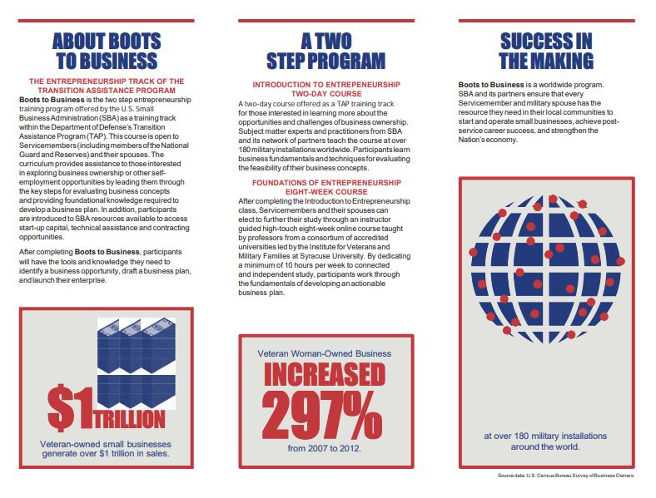
BOOTS TO BUSINESS (B2B)
Boots to Business Overview
Boots to Business (B2B) is an entrepreneurial education and training program offered by the U.S. Small Business Administration (SBA) as part of the Department of Defense's Transition Assistance Program (TAP). B2B provides participants with an overview of business ownership and is open to transitioning service members (including National Guard and Reserve) and their spouses.

Slide 24
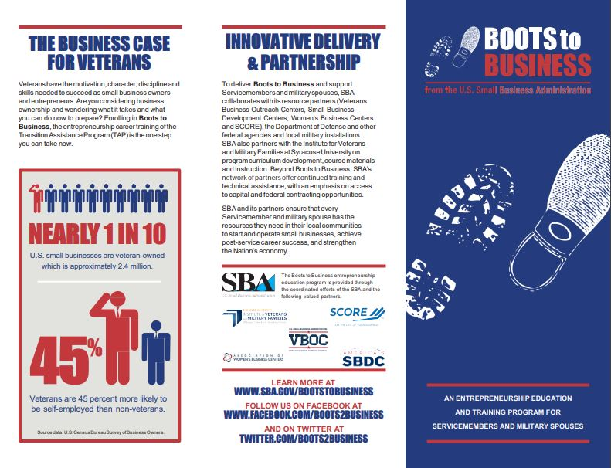
BOOTS TO BUSINESS (b2b)
Boots to Business is delivered in partnership with SBA’s Resource Partners, SCORE Mentors, Small Business Development Centers, Women’s Business Centers, and Veterans Business Outreach Centers and the Institute for Veterans and Military Families at Syracuse University. It is available free of charge at participating installations to service members and their dependents transitioning or retiring from the U.S. military.

Slide 25
LOCAL KC VETERAN ORGANIZATIONS ASSISTING VETERANS WITH JOB PLACEMENT
CATHOLIC CHARITIES
Heart of America stand down
St. Michael’s veterans center
Veterans community project

Slide 26
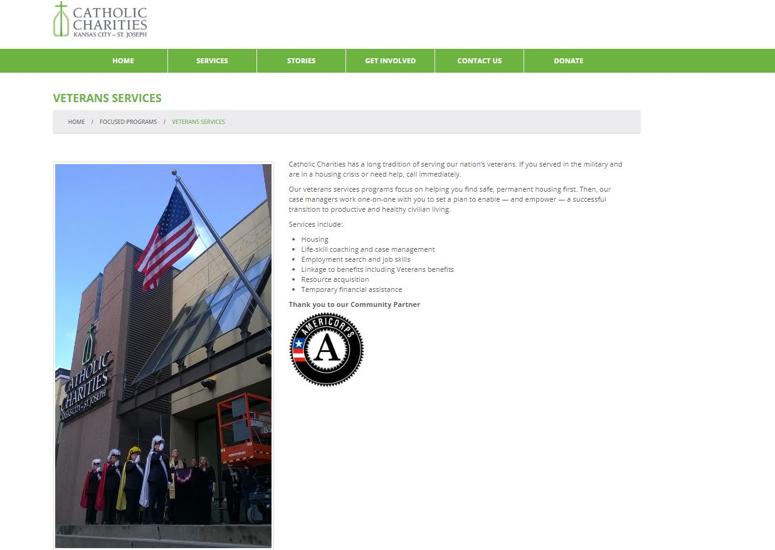
Catholic Charities of Kansas City – St. Joseph

Slide 27
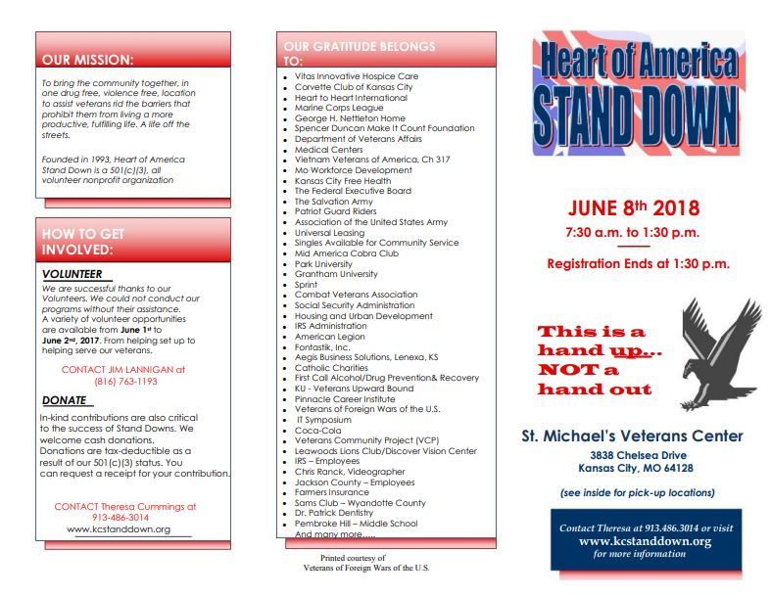
Heart of America Stand Down

Slide 28
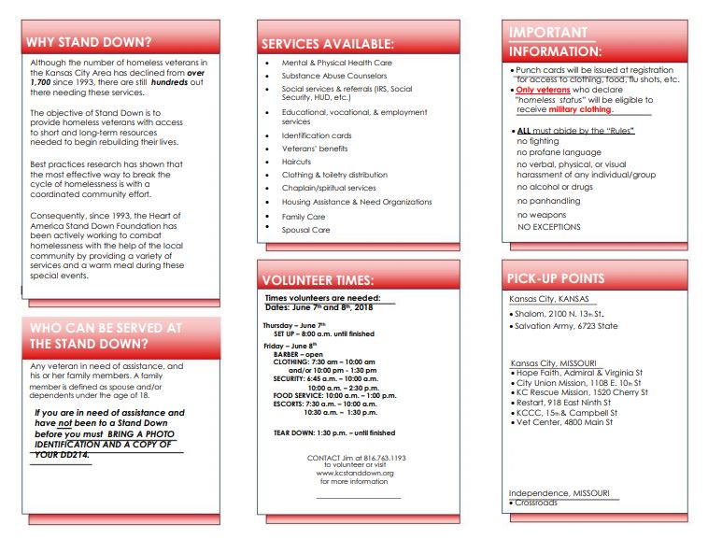
Heart of America Stand Down

Slide 29
St. Michael's Veterans Center

Slide 30
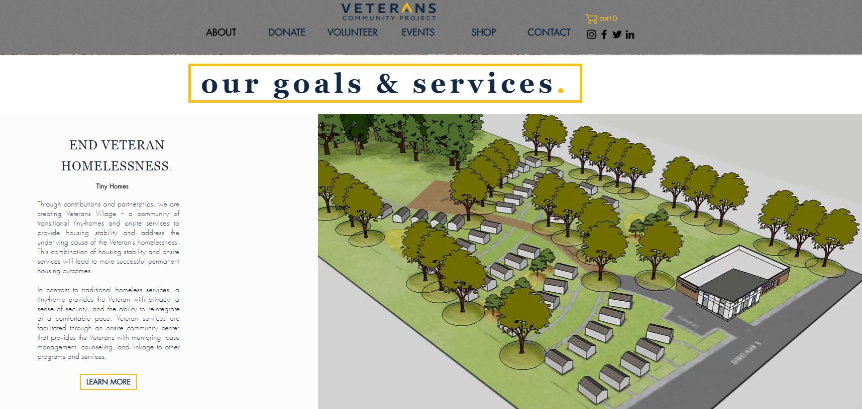
Veterans Community Project (VCP)

Slide 32
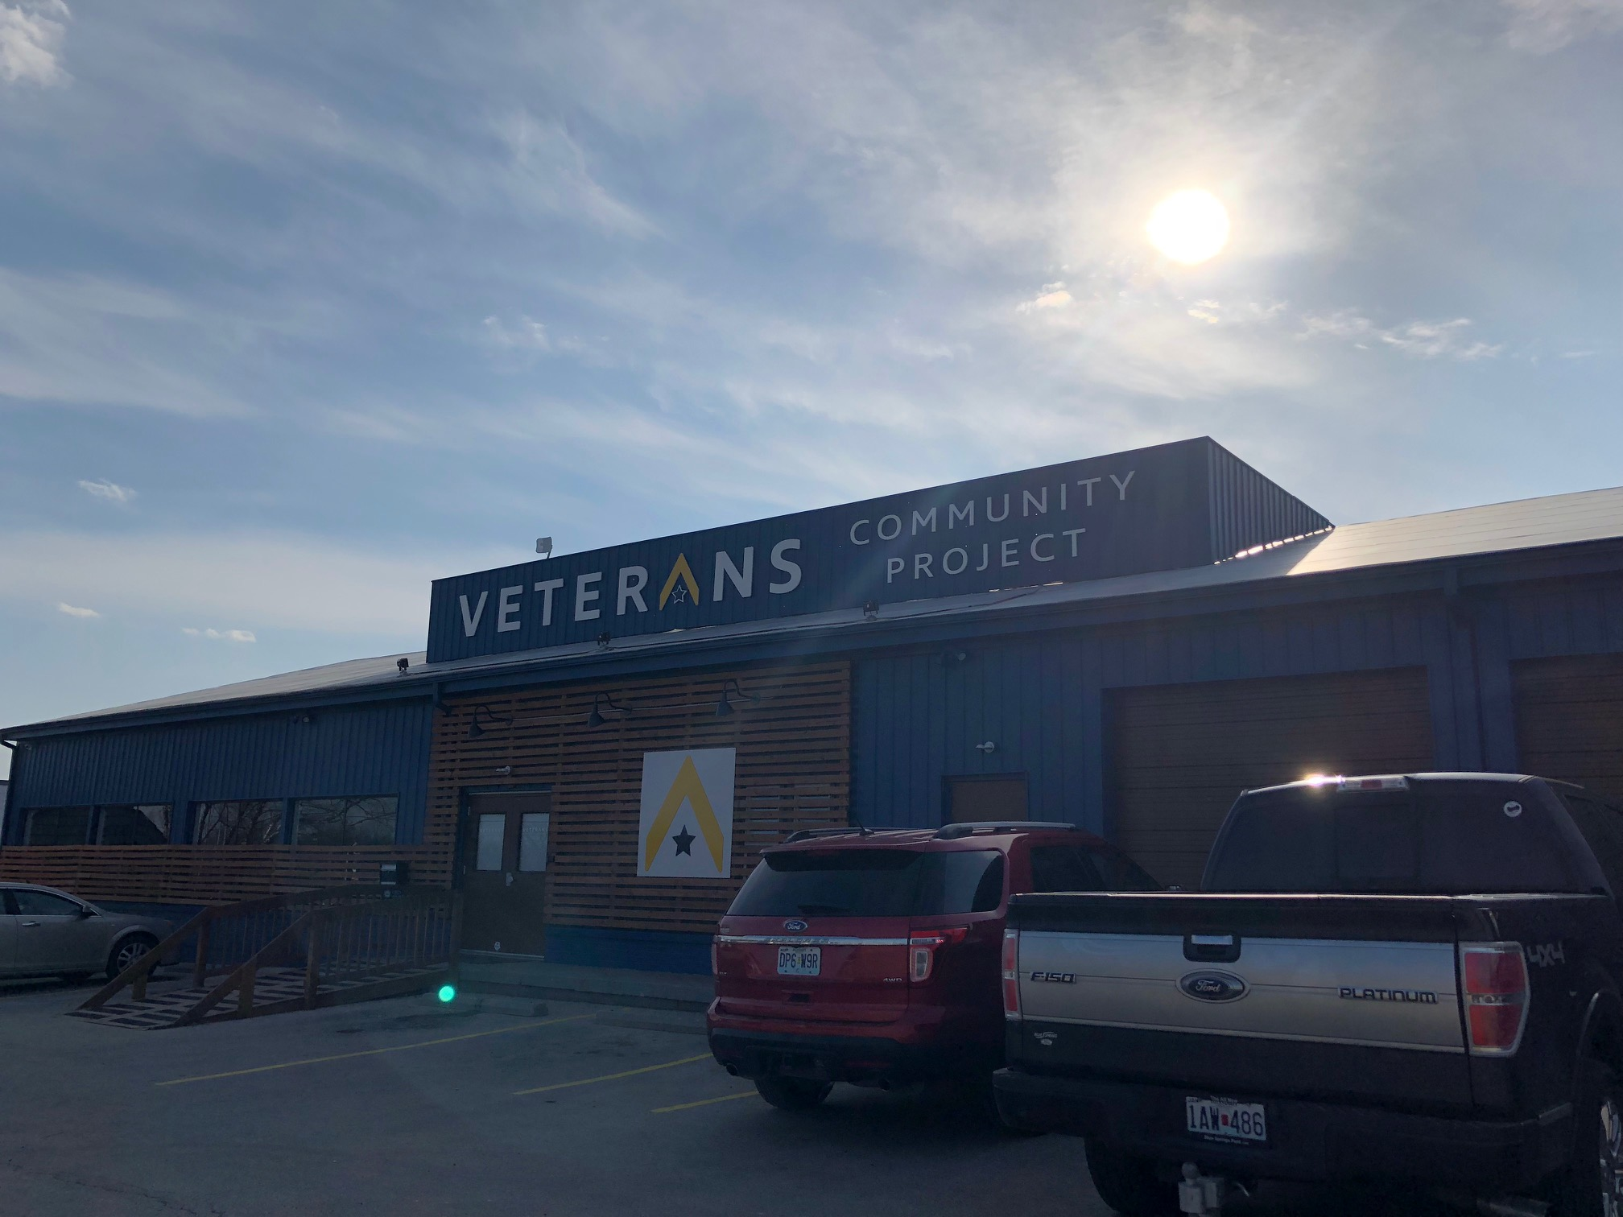
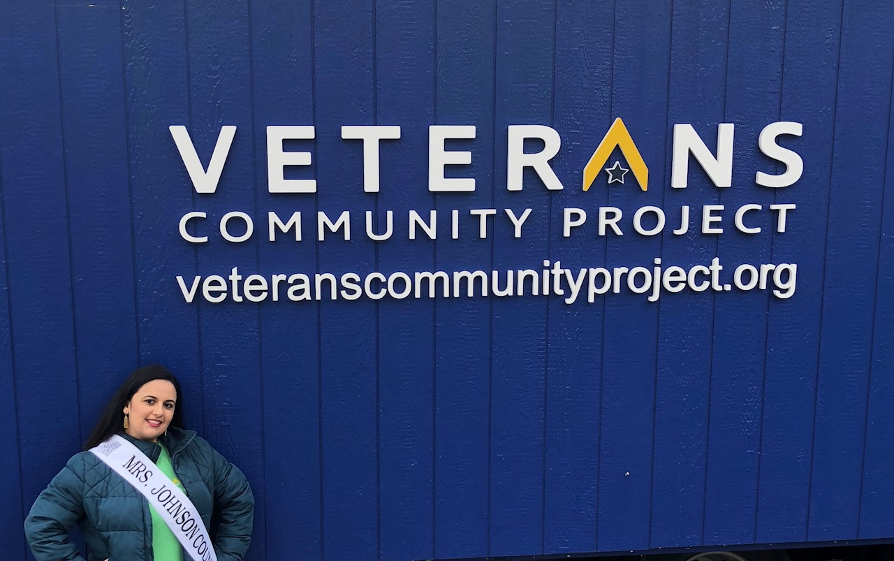
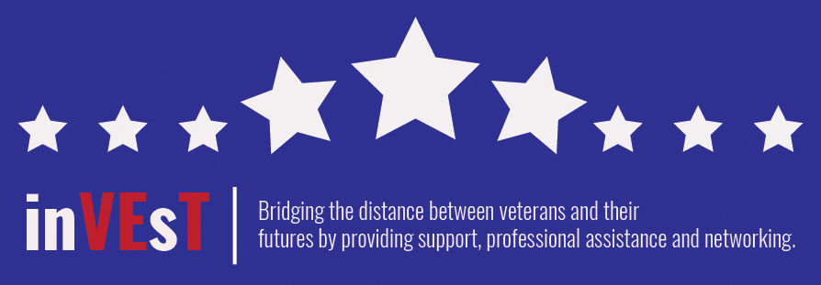

Slide 33
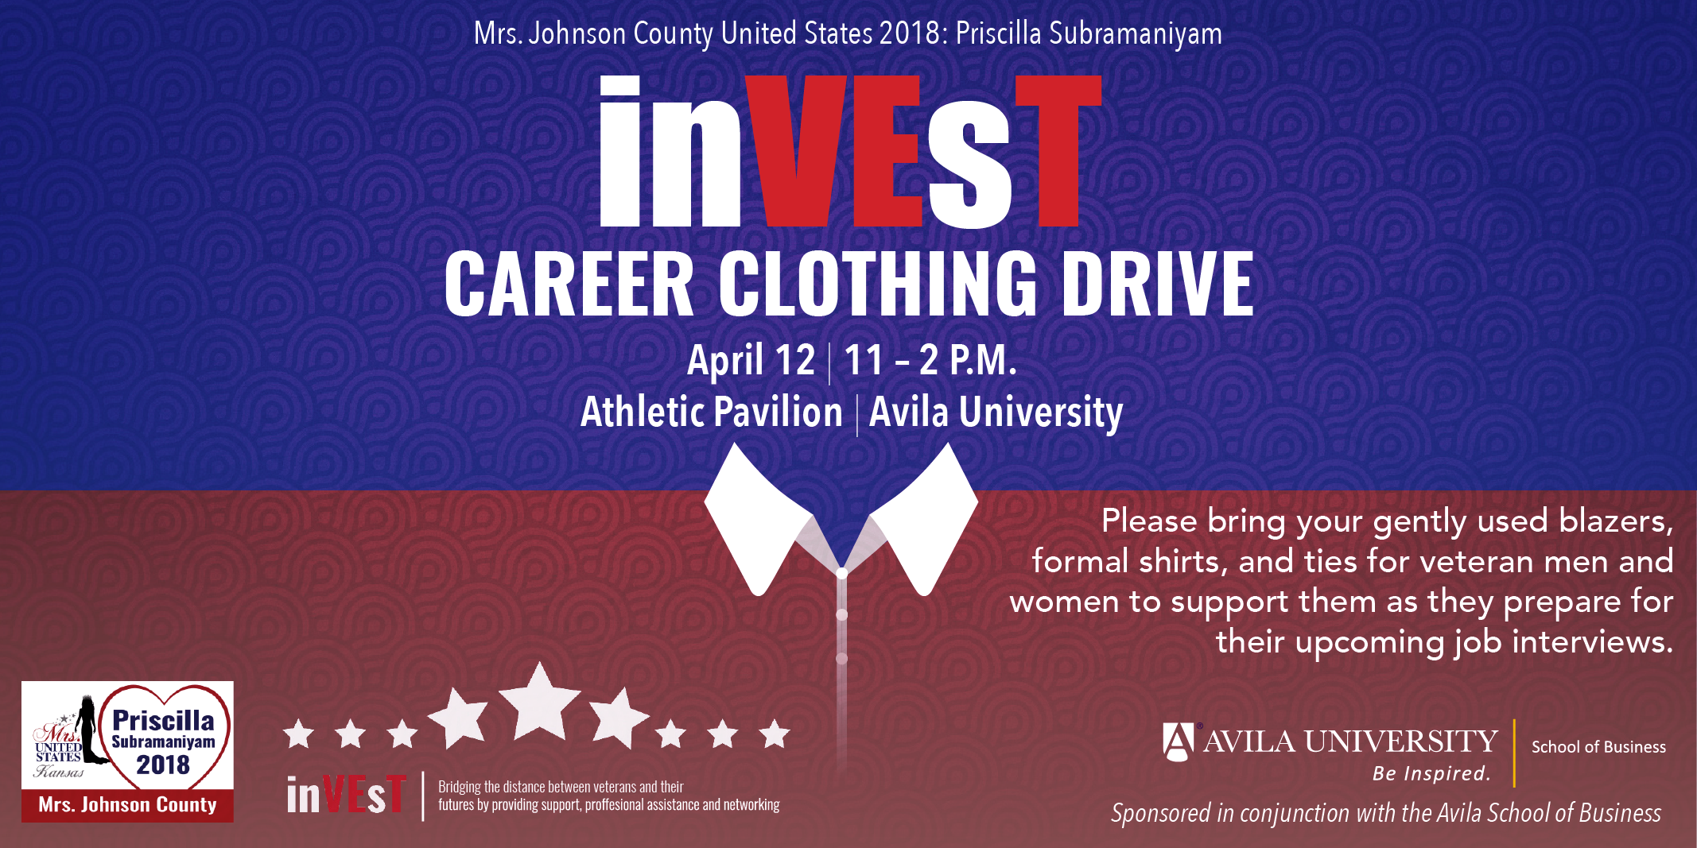

Slide 34
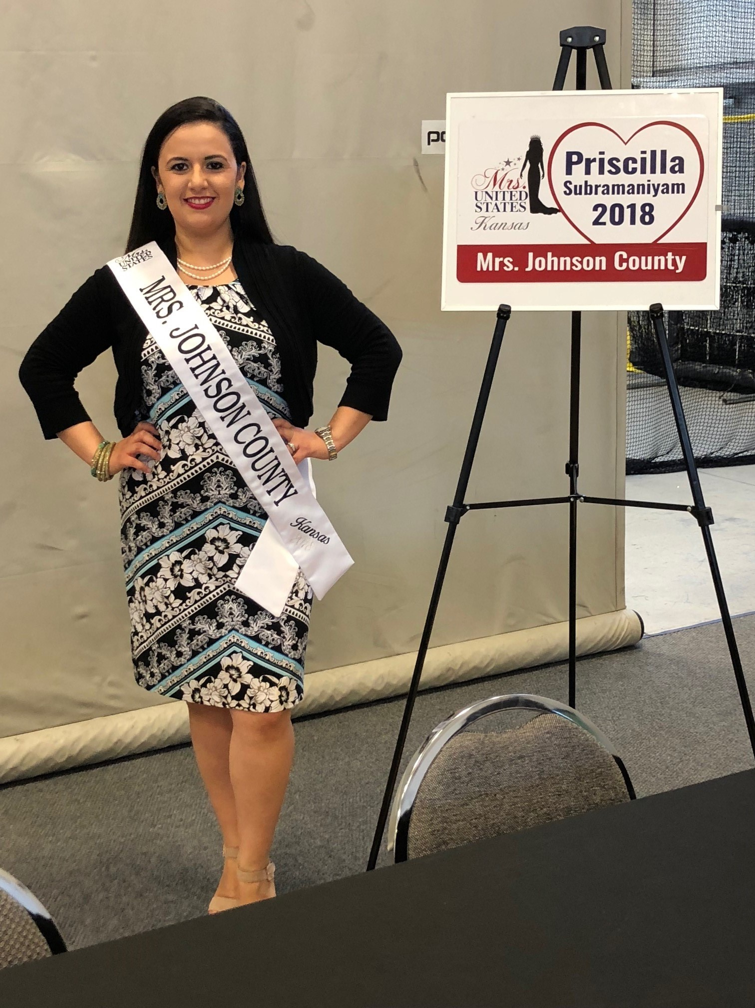

Slide 35
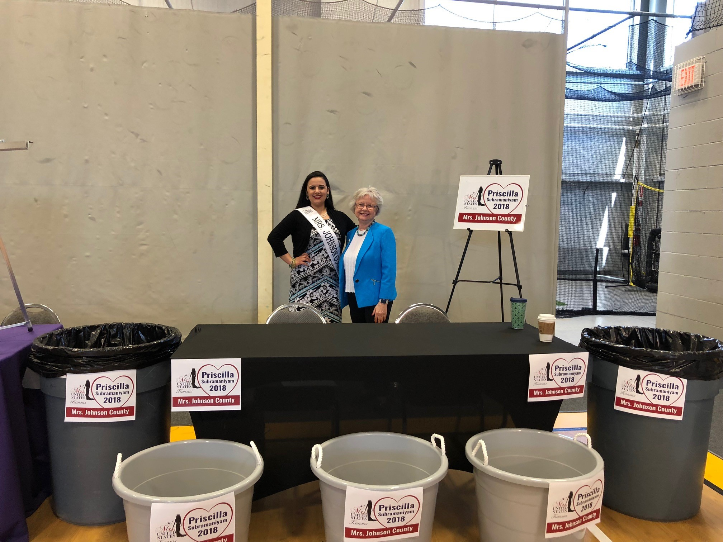

Slide 36
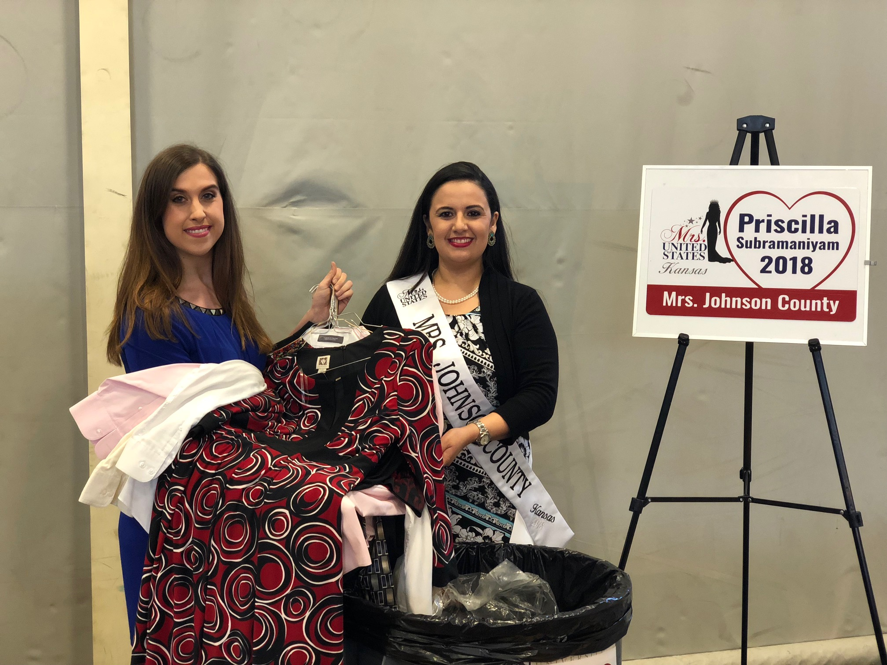

Slide 37
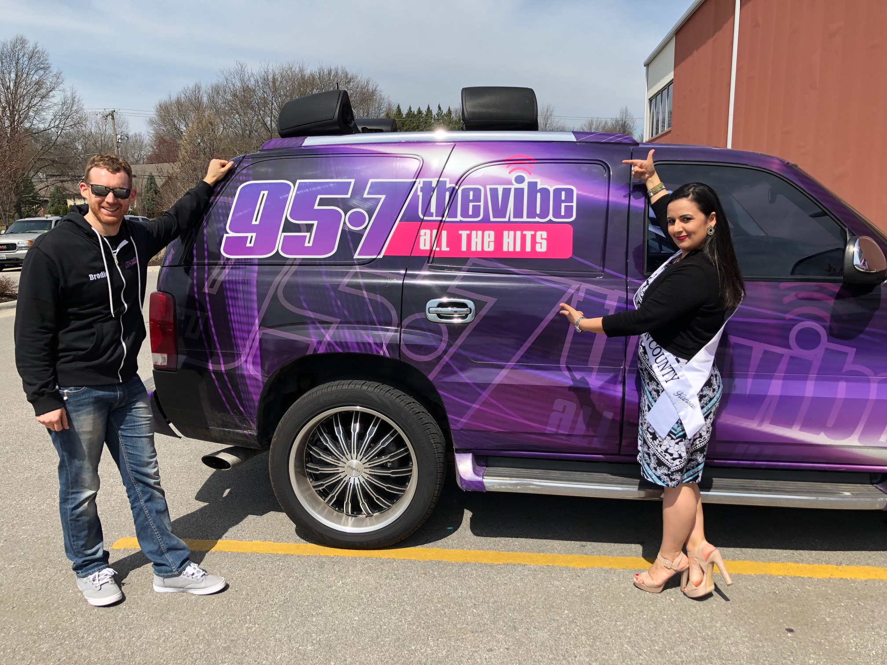
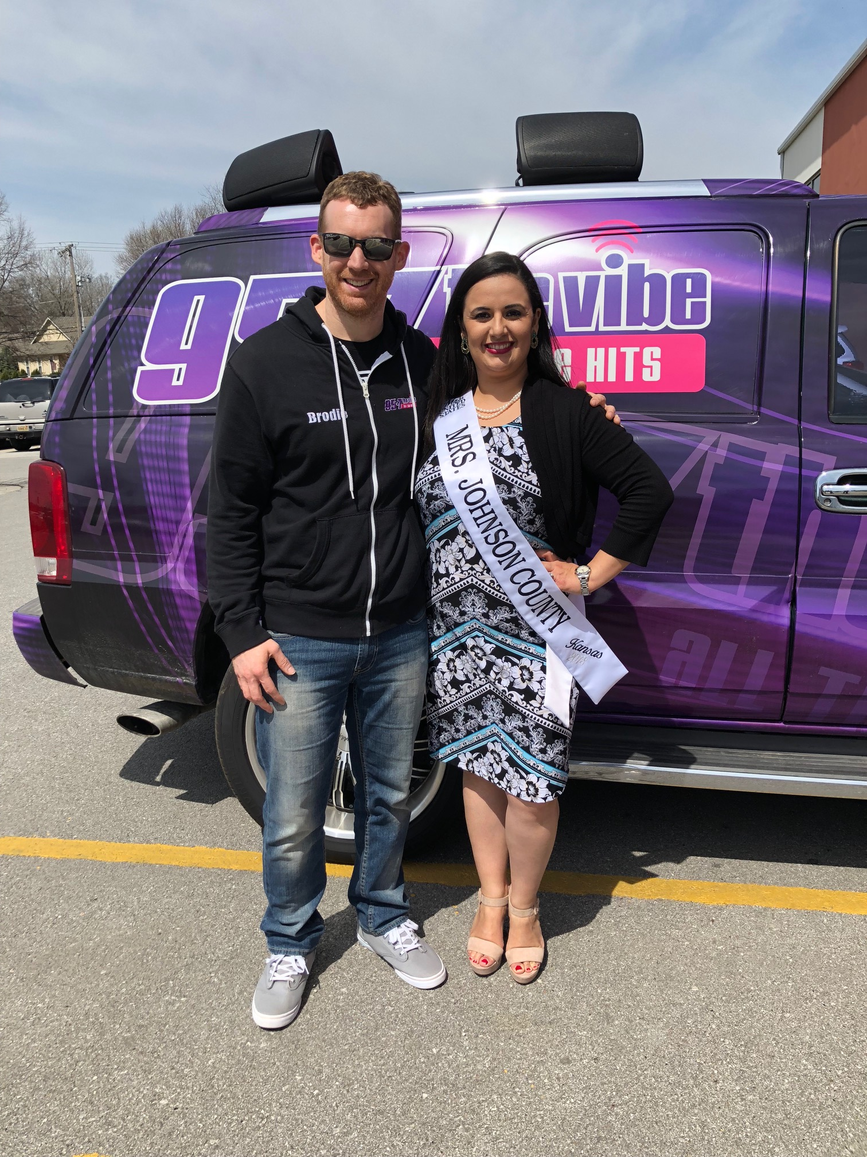

Slide 38
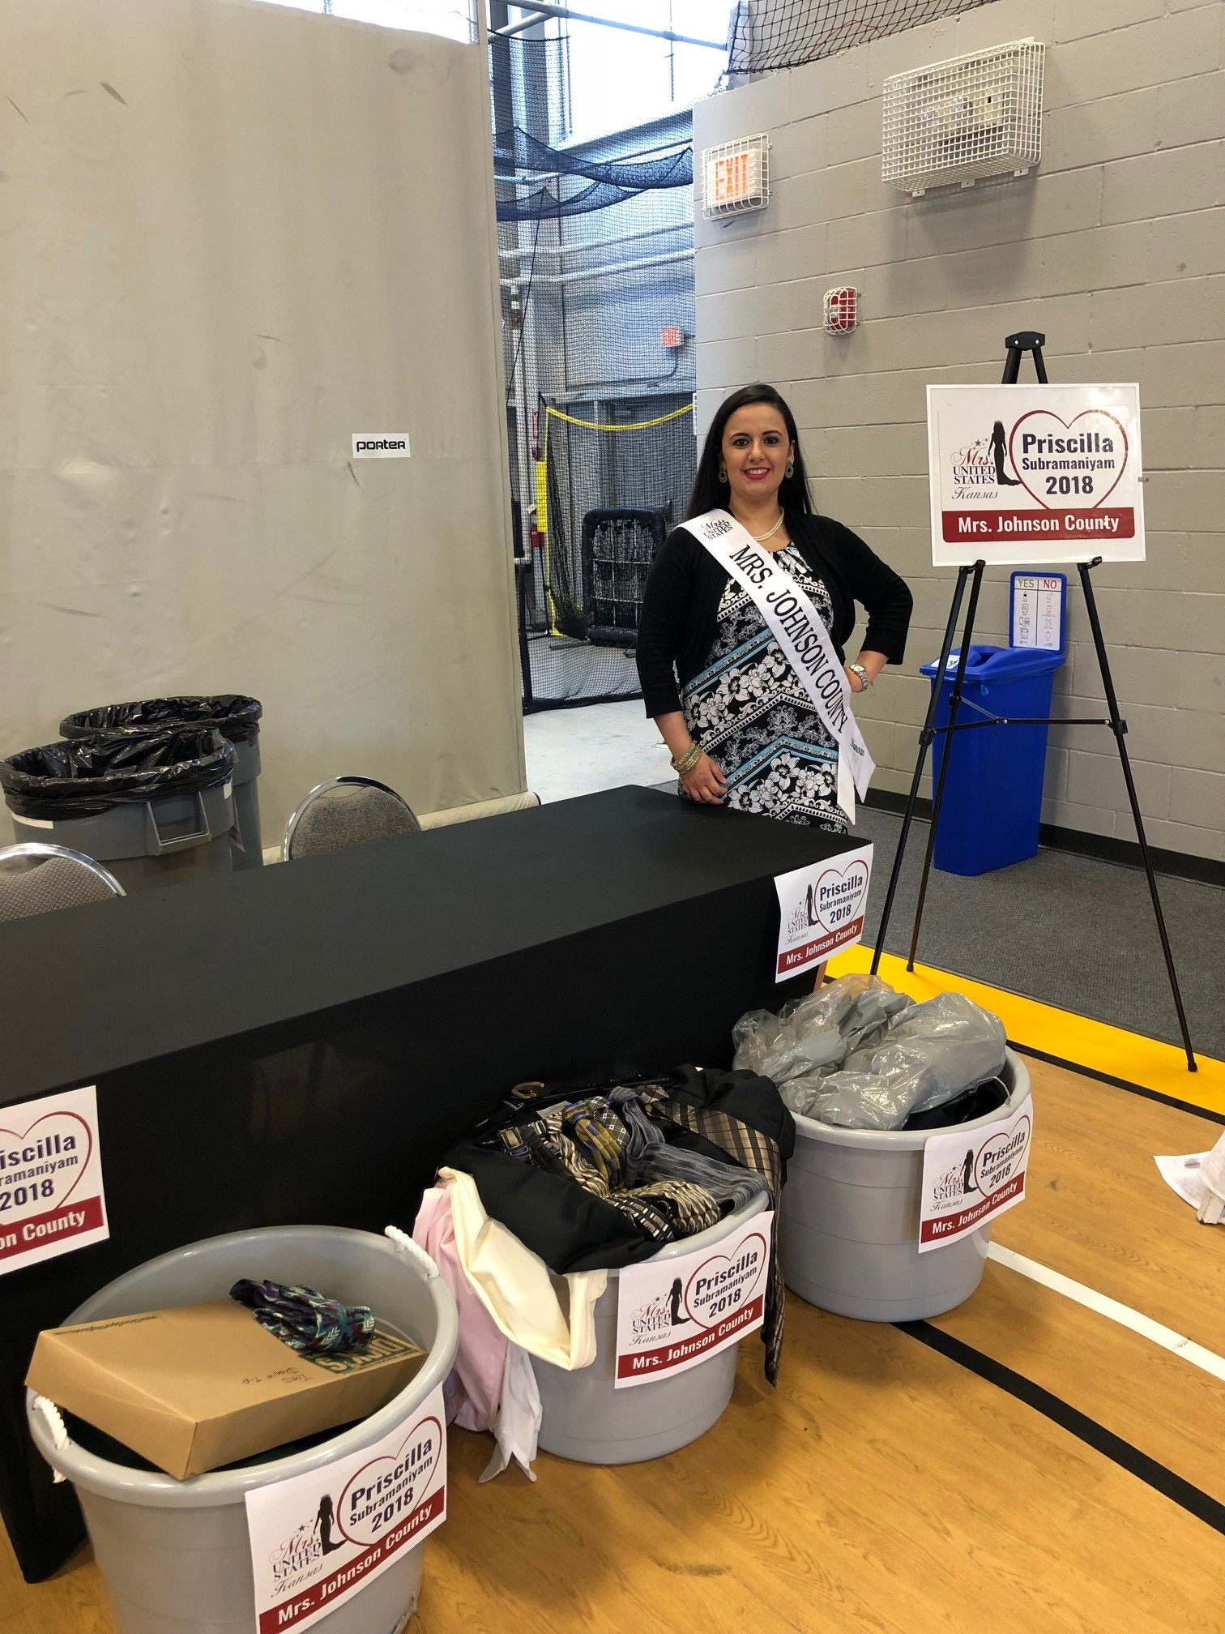

Slide 39
Works cited
Women in the Military: From Service to Civilian Life – Infographic
White paper: Operation boots to business veteran entrepreneurship assessment
“THREE THINGS VETERANS SHOULD INCLUDE ON THEIR RESUME AND IN AN INTERVIEW” - vaNTAGE POINT: official blog of the U.S. DEPARTMENT OF VETERAN AFFAIRS
Boots to business (B2B) – u.s. small business administration
CATHOLIC CHARITIES KANSAS City – St. joseph: veteran services
Heart of AMERICA STAND DOWN
St. Michael's veteran center
VETERANS COMMUNITY PROJECT (vcp)

Slide 40
The institute for veterans and military families: SYRACUSE UNIVERSITY
The Institute for Veterans and Military Families (IVMF) is the first interdisciplinary national institute in higher education focused on the social, economic, education and policy issues impacting veterans and their families. Through its professional staff and experts, the IVMF delivers leading programs in career, vocational and entrepreneurship education and training while also conducting actionable research, policy analysis and program evaluations.
The IVMF also supports communities through collective impact efforts that enhance delivery and access to services and care. The institute, supported by a distinguished advisory board, along with public and private partners, is committed to advancing the lives of those who have served in America’s armed forces and their families.

